Slide 1

22/03
MEMBERS
PHYO HEIN HLAING
THEIN KYAW LWIN
MYO MYINT KYAW
WINE HTET HEIN
NANDAR LAMIN AYE
LIN HTET PAING
KAUNG HTET LYNN
THINN THINN HTET SU
MON AUNG MYA
MJECHAL
HYBRID-ELIZA-MM
GROUP-3
PRESENTED BY GROUP 3
PRESENTATION
PAGE 1

Slide 2
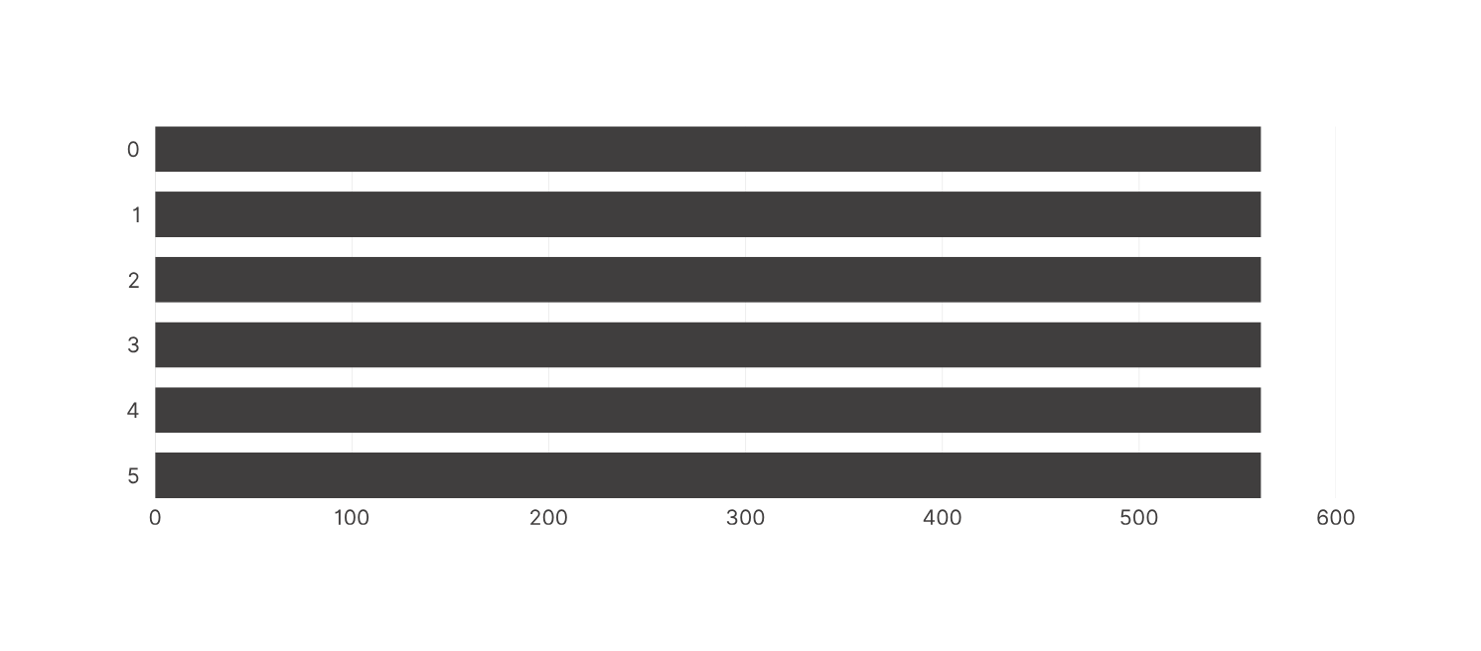
GROUP 3
22/03
DATA OVERVIEW
QUANTITY
PRESENTED BY GROUP 3
PRESENTATION
PAGE 2

Slide 3
GROUP 3
22/03
Preprocessing For Training Data
zawgyi to unicode transform လုပ်ပါတယ် [myanmartools, rabbit]
Url or link remove လုပ်ပါတယ်
Emoji တွေပါလာရင် remove လုပ်ပါတယ် [emoji]
Special charcter ကို remove လုပ်ပါတယ် [string]
English words တွေ numbers တွေကို remove လုပ်ပါတယ်
Words ကို segmentation ပိုင်းပါတယ် [icu]
စာကြောင်းတစ်ကြောင်းထဲမှာပါနေတဲ့ duplicated words တွေကို remove လုပ်ပြီး တစ်လုံးထဲပြန်ယူပါတယ်
စစ်ထားပြီးသား data တွေမှာ duplicated row တွေကို remove လုပ်ပါတယ် [pandas]
PRESENTED BY GROUP 3
PRESENTATION
PAGE 3

Slide 4
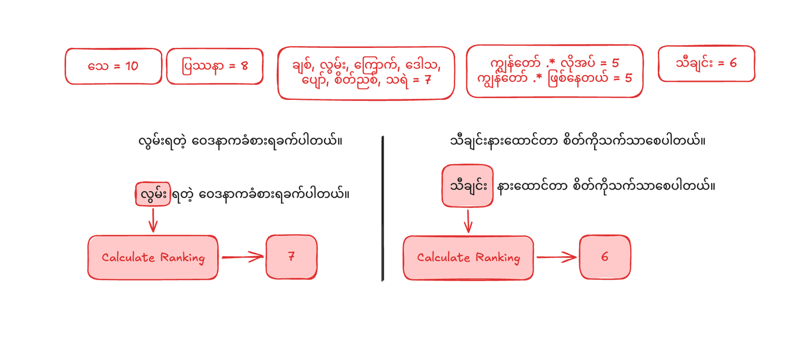
GROUP 3
22/03
Calculating Rank For Rule Based
PRESENTED BY GROUP 3
PAGE 4

Slide 5
GROUP 3
22/03
Performance Overview
METRIC | ACCURACY SCORE
Epochs 10, Learning Rate 0.003 | 0.7764
Epochs 10, Learning Rate 0.002 | 0.7496
Epochs 10, Learning Rate 0.001, drop out 0.2 | 0.7585
Epochs 10, Learning Rate 0.002, drop out 0.2 | 0.7621
PRESENTED BY GROUP 3
PRESENTATION
PAGE 5

Slide 6
GROUP 3
22/03
Classification Report
EPOCHS 10, LEARNING RATE 0.003
 | PRECISION | RECALL | F1-SCORE
Sadness | 0.7764 | 0.8090 | 0.8182
Joy | 0.6747 | 0.6588 | 0.6667
Love | 0.7549 | 0.7333 | 0.7440
Anger | 0.8415 | 0.8519 | 0.8466
Fear | 0.8000 | 0.9072 | 0.8502
Surprise | 0.7579 | 0.7059 | 0.7310
accuracy |  |  | 0.7764
PRESENTED BY GROUP 3
PAGE 6

Slide 7
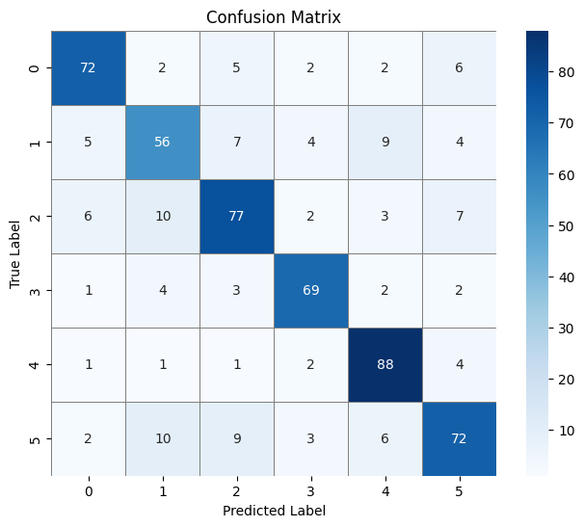
GROUP 3
22/03
PRESENTED BY GROUP 3
PRESENTATION
PAGE 7

Slide 8
GROUP 3
22/03
Classification Report
EPOCHS 10, LEARNING RATE 0.002
 | PRECISION | RECALL | F1-SCORE
Sadness | 0.8171 | 0.7528 | 0.7836
Joy | 0.6623 | 0.6000 | 0.6296
Love | 0.7037 | 0.7238 | 0.7136
Anger | 0.8250 | 0.8148 | 0.8199
Fear | 0.8000 | 0.8660 | 0.8317
Surprise | 0.7009 | 0.7353 | 0.7177
accuracy |  |  | 0.7496
PRESENTED BY GROUP 3
PAGE 8

Slide 9
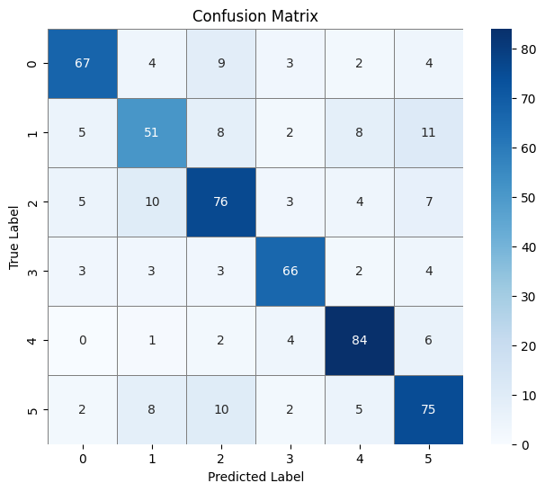
GROUP 3
22/03
PRESENTED BY GROUP 3
PRESENTATION
PAGE 9

Slide 10
GROUP 3
22/03
Classification Report
EPOCHS 10, LEARNING RATE 0.001, DROP OUT 0.2
 | PRECISION | RECALL | F1-SCORE
Sadness | 0.8434 | 0.7865 | 0.8140
Joy | 0.6180 | 0.6471 | 0.6322
Love | 0.7500 | 0.6571 | 0.7005
Anger | 0.8571 | 0.8148 | 0.8354
Fear | 0.8113 | 0.8866 | 0.8473
Surprise | 0.6964 | 0.7647 | 0.7290
accuracy |  |  | 0.7585
PRESENTED BY GROUP 3
PAGE 10

Slide 11
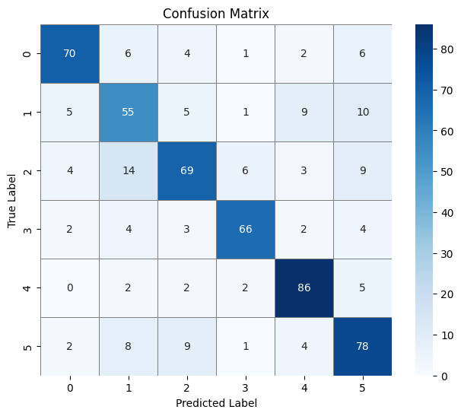
GROUP 3
22/03
PRESENTED BY GROUP 3
PRESENTATION
PAGE 11

Slide 12
GROUP 3
22/03
Classification Report
EPOCHS 10, LEARNING RATE 0.002, DROP OUT 0.2
 | PRECISION | RECALL | F1-SCORE
Sadness | 0.7865 | 0.7865 | 0.7865
Joy | 0.6500 | 0.6118 | 0.6303
Love | 0.7383 | 0.7524 | 0.7453
Anger | 0.7738 | 0.8025 | 0.7879
Fear | 0.8318 | 0.9175 | 0.8725
Surprise | 0.7717 | 0.6961 | 0.7320
accuracy |  |  | 0.7621
PRESENTED BY GROUP 3
PAGE 12

Slide 13
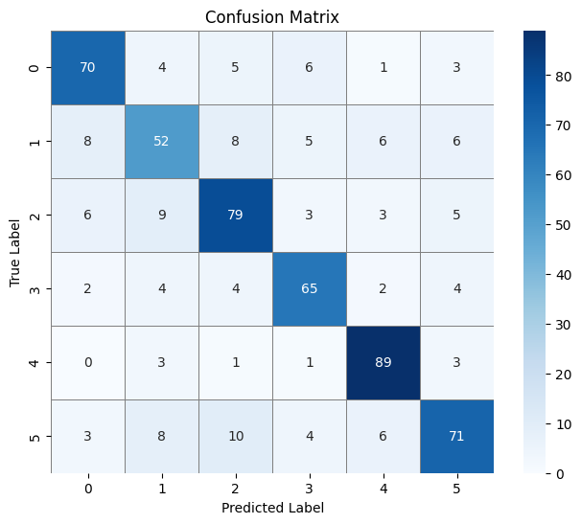
GROUP 3
22/03
PRESENTED BY GROUP 3
PRESENTATION
PAGE 13

Slide 14
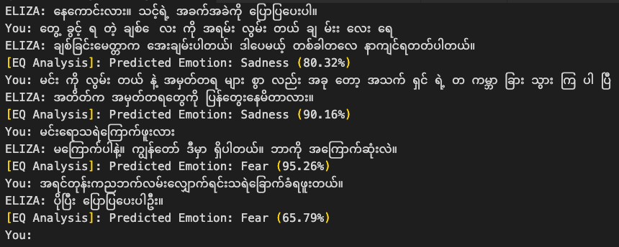
GROUP 3
22/03
Demo
PRESENTED BY GROUP 3
PAGE 14

Slide 15
GROUP 3
22/03
THANKYOU
PRESENTED BY GROUP 3
PRESENTATION
PAGE 15

